Slide 1
Focus on Pharmacology:
Essentials for Health Professionals
Third Edition
Chapter 7
Administration of Medications

Slide 2
Introduction
Medications may cause serious harm.
Orders are from physician or authorized health care professional, per state law.
Every state has a medical practice act that defines whether a medical assistant or other caregiver (besides a nurse) can administer drugs under the supervision of a physician.
Vigilance needed to prevent errors and ensure quality patient care.

Slide 3
Principles of Drug Administration
Assess patient health.
Before giving medications, obtain:
  Medication history.
  Vitamin, herb, and food supplement use.
Determine suitable route of administration.
Assess socioeconomic factors.
  Ability to self-administer (if applicable)
continued on next slide

Slide 4
Principles of Drug Administration
Seven Rights of Drug Administration
  The right patient
  The right drug
  The right dose
  The right route
  The right time
  The right technique
  The right documentation
continued on next slide

Slide 5
Principles of Drug Administration
The right patient
  Ask the patient his or her name or call the patient by name before administering the medication.
  Always check for allergies before administering medications.
The right drug
  Each time a drug is dispensed, the medication label must be checked three times during its preparation to confirm the right drug, right dose, and right strength.
  Compare the physician’s written order with the label.
continued on next slide

Slide 6
Principles of Drug Administration
The right dose
  Perform appropriate dosage calculations to determine the accurate dose.
  Measure it out carefully.
  Medication errors are significantly reduced by using unit-dose systems.
The right route
  Clarify the route of administration for the medication—whether it is oral, topical, or parenteral.
continued on next slide

Slide 7
Principles of Drug Administration
The right time
  Clarify the appropriate time for medications to be administered.
The right technique
The right documentation
  Document:
    The date and time of administration
    The drug’s name, strength, dose, and route of administration
    Any patient reactions to the medication
    Details of patient education regarding the drug
continued on next slide

Slide 8
Principles of Drug Administration
Safety in Drug Administration
  Certain procedures must be performed to ensure patient safety.
  Physician's order must be completely understood and clearly read.
    If needed, look up drug in a handbook.
    Dispense and administer after all these steps.

Slide 9
Routes of Drug Administration
Method of administration depends on purpose of medication.
  Enteral
    Absorption through GI tract
  Parenteral
    Injection (systemic effects)
  Percutaneous
    Direct contact with skin or mucous membranes
continued on next slide

Slide 10
Routes of Drug Administration
Enteral Routes
  Route of drug administration through the GI tract
  Safe and convenient for most patients
  Relatively economical
continued on next slide

Slide 11
Routes of Drug Administration
Enteral Routes
  Oral route
    Route of choice if able to swallow and retain drug in stomach
    Absorbed from stomach and small intestine
    Metabolized by liver (first-pass metabolism)
    Contraindicated when a patient is vomiting, has gastric or intestinal suction, or is unconscious
continued on next slide

Slide 12
Routes of Drug Administration
Enteral Routes
  Nasogastric and gastrostomy routes
    Nasogastric (NG) tube
      Inserted through nasopharynx into stomach
    Gastrostomy tube
      Surgically placed directly into stomach
continued on next slide

Slide 13
Routes of Drug Administration
Enteral Routes
  Sublingual route
    Placed under tongue until completely dissolved
    Used when rapid action is desired
      Medication bypasses the GI tract and goes directly from oral mucosa to systemic circulation.
    Examples include:
      Nitroglycerin (Nitrostat) for angina pectoris
      Ergotamine tartrate (Ergomar) for migraines

Slide 14
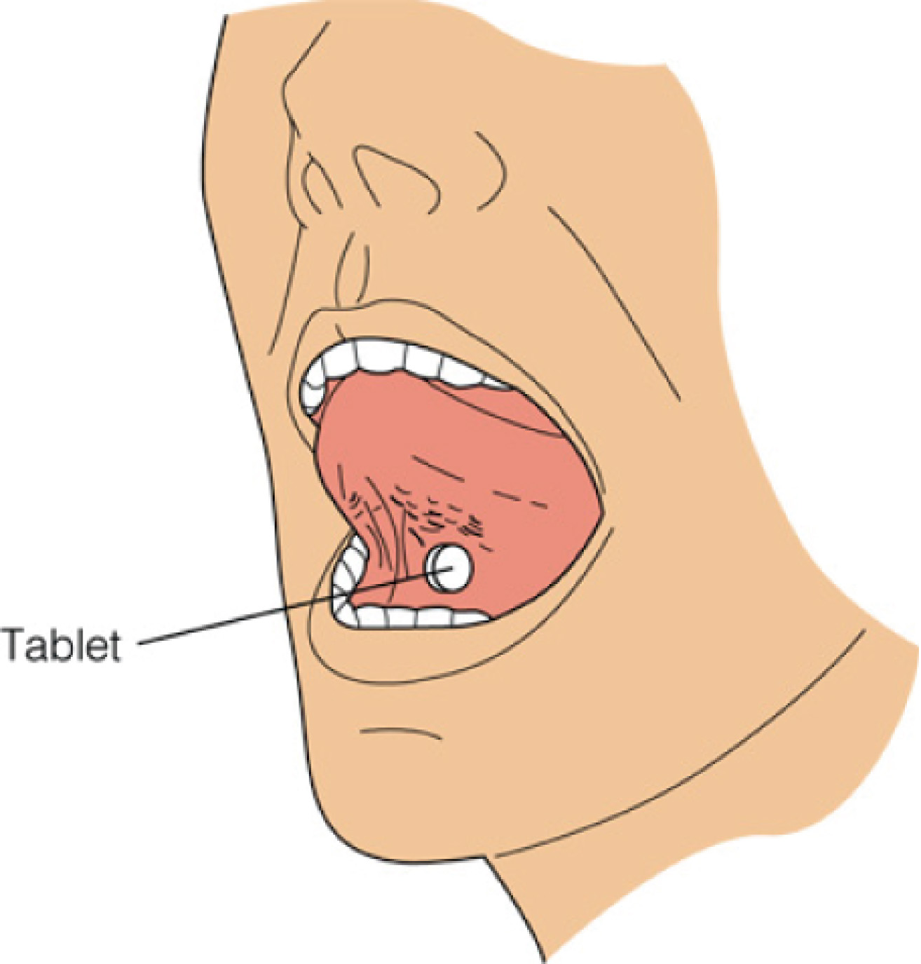
Figure 7-1 Medication given via the sublingual route.

Slide 15
Routes of Drug Administration
Enteral Routes
  Buccal route
    A type of percutaneous route
    Medication placed between gum and cheek until it dissolves.
    Preferred over sublingual route for sustained-release delivery due to greater mucosal surface area

Slide 16
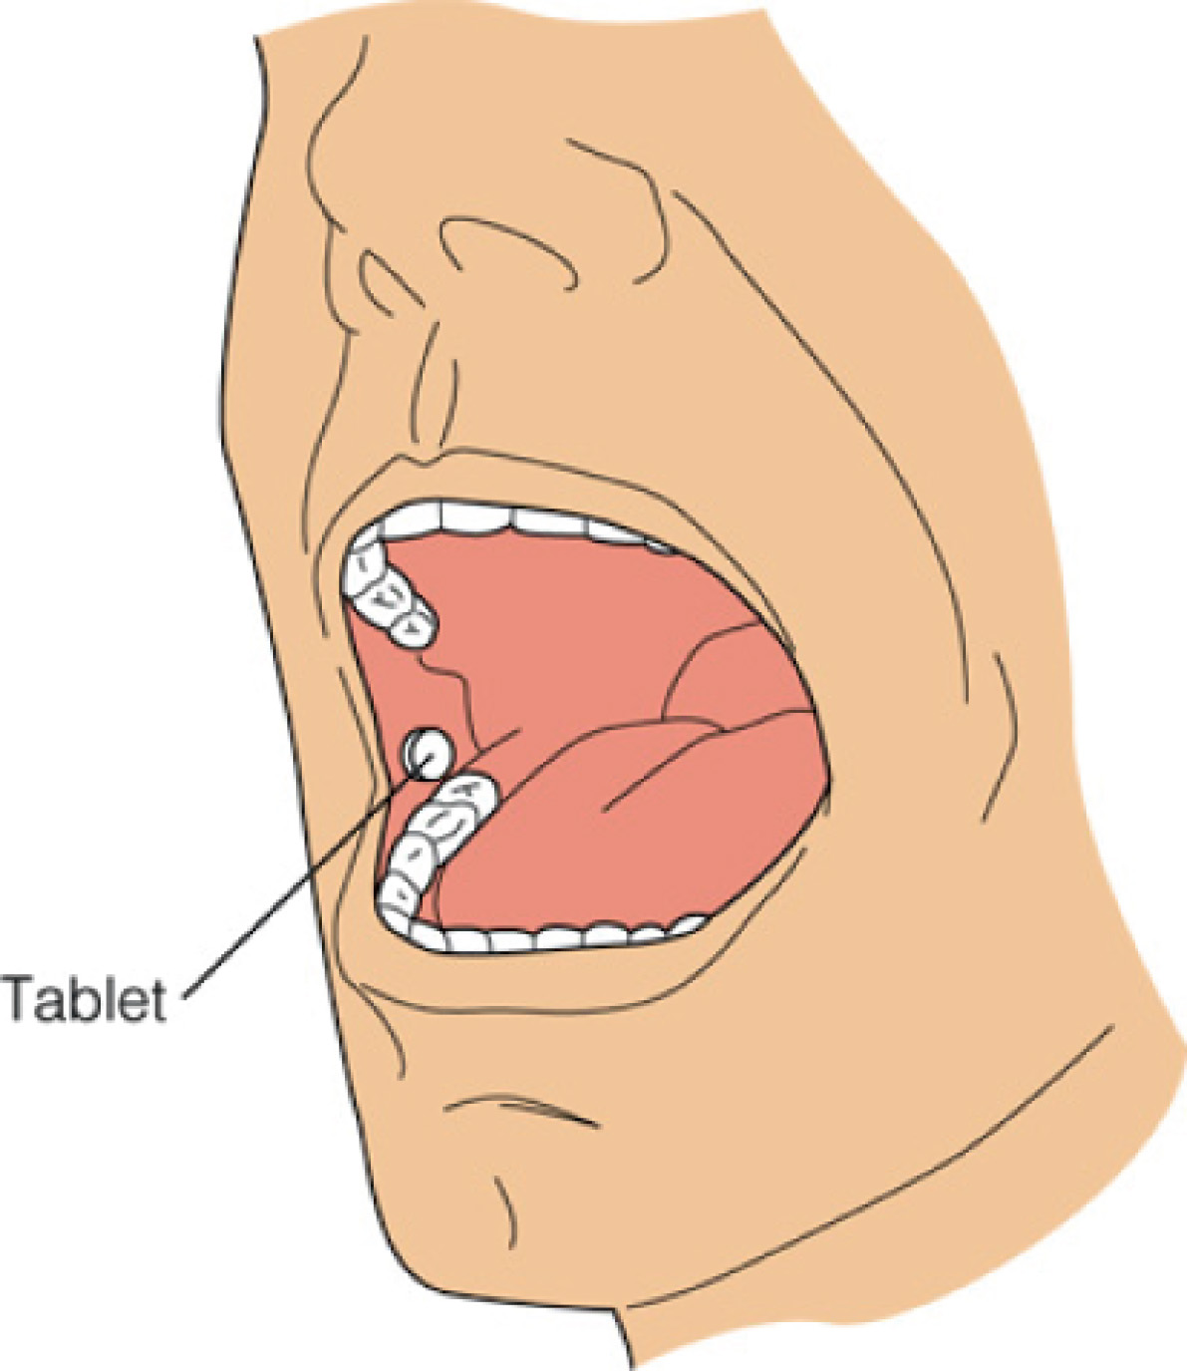
Figure 7-2 Administration of drugs via the buccal route.

Slide 17
Routes of Drug Administration
Parenteral Routes
  Injection of a drug into the body with a needle and syringe
  May be given via intradermal (ID), subcutaneous (SC), intramuscular (IM), or intravenous (IV) routes
  More quickly absorbed than oral route
  Irretrievable once injected
  Require invasive procedure and aseptic technique required to avoid infection
continued on next slide

Slide 18
Routes of Drug Administration
Parenteral Routes
  Equipment
    Ampules and vials
      Contain medication drawn into syringe
    Syringes and needles
      Withdraw medication and administer to patient
continued on next slide

Slide 19
Routes of Drug Administration
Parenteral Routes
  Equipment
    Syringes
      Barrel
        Outside part
        Printed measuring scales
      Plunger
        Fits inside barrel
continued on next slide

Slide 20
Routes of Drug Administration
Parenteral Routes
  Equipment
    Syringes
      Tip
        Connects with needle
      No unsterile object should contact:
        Tip or inside of barrel
        Plunger shaft
        Needle shaft or tip

Slide 21
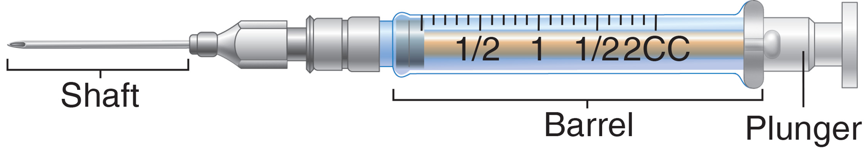
Figure 7-3 The plunger and barrel of a standard syringe, attached to a needle, with its shaft portion identified.

Slide 22
Routes of Drug Administration
Parenteral Routes
  Equipment
    Syringes
      Insulin syringes
        Calibrated in 50-unit or 100-unit sizes
        Permanently attached needles
        No dead space
continued on next slide

Slide 23
Routes of Drug Administration
Parenteral Routes
  Equipment
    Syringes
      Tuberculin syringes
        Hold 1-mL
        Calibrated in hundredths of milliliters
continued on next slide

Slide 24
Routes of Drug Administration
Parenteral Routes
  Equipment
    Syringes
      Hypodermic syringes
        Available in 2-, 2.5-, 3-, and 5-mL sizes
        Commonly used to administer IM injections

Slide 25
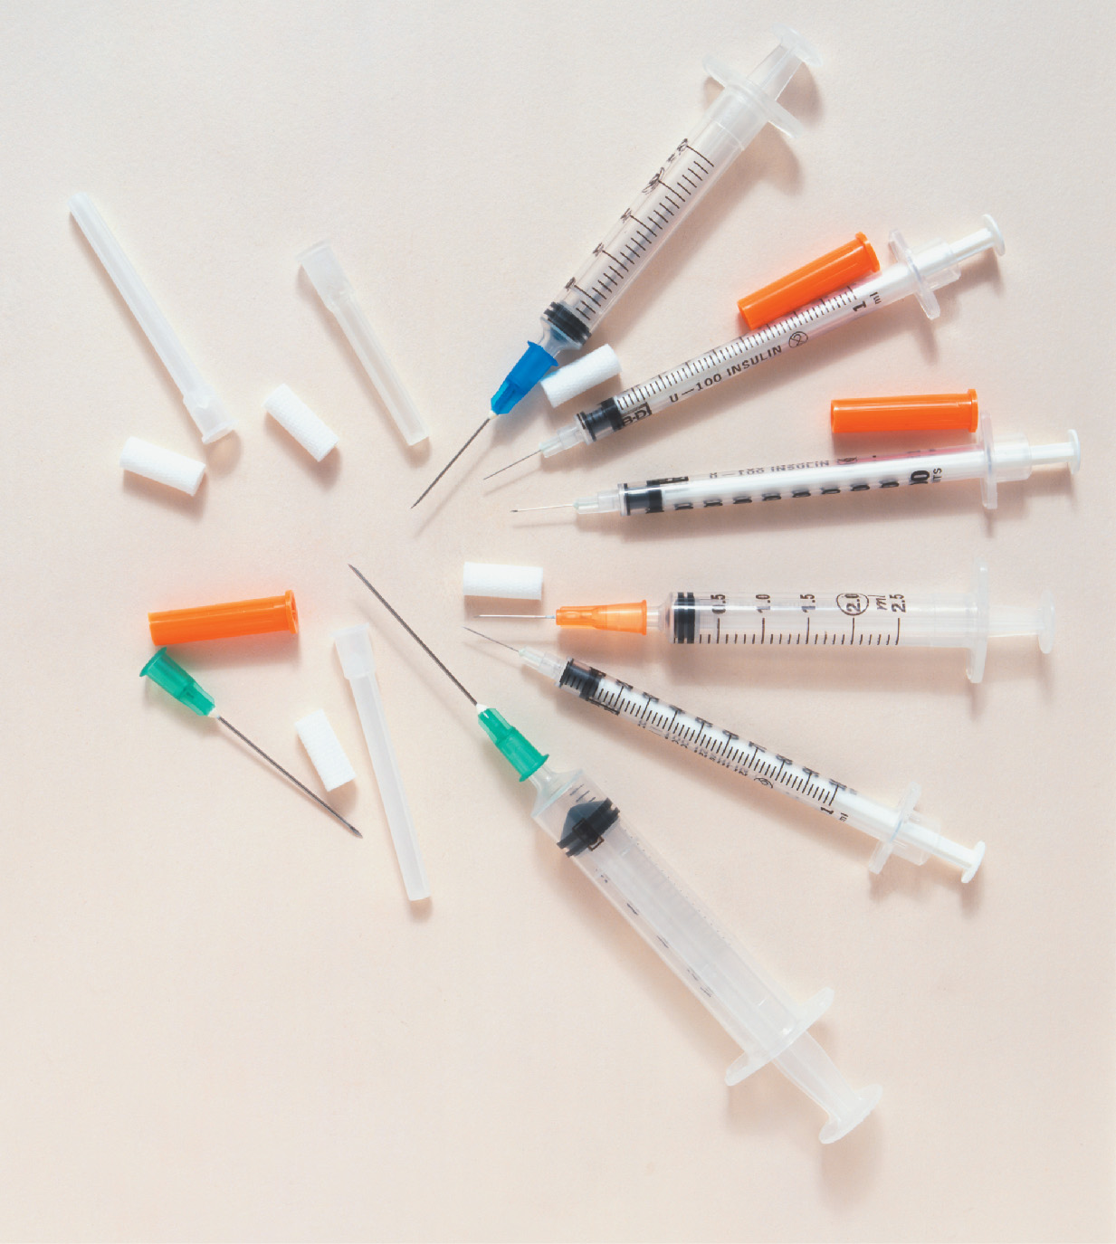
Figure 7-4 Examples of tuberculin, insulin, and 3-mL hypodermic syringes.
Dave King/DK Images

Slide 26
Routes of Drug Administration
Parenteral Routes
  Equipment
    Syringes
      Unit-dose injections
        Prefilled syringes, ready to use
        Prefilled sterile cartridges, needles attached to reusable holder (injection system) before use

Slide 27
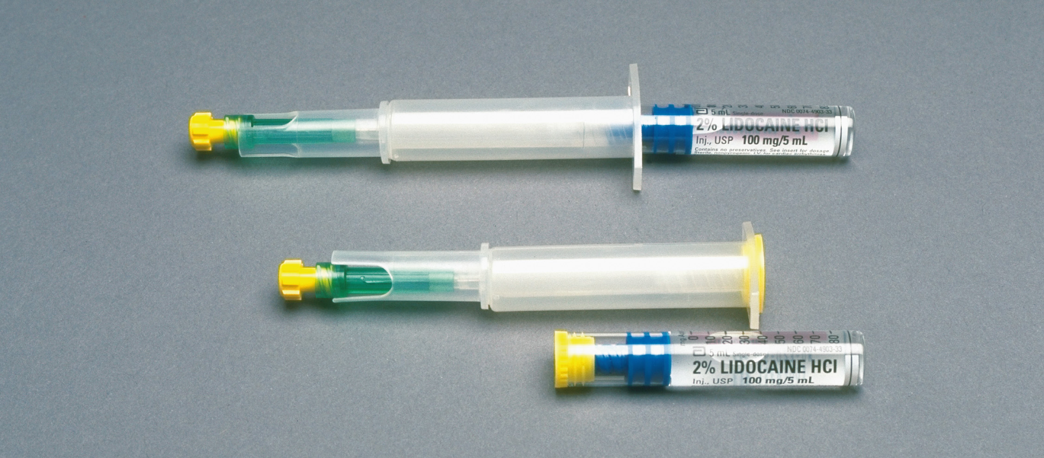
Figure 7-5 Prefilled unit-dose systems.
Michal Heron/Pearson Education/PH College

Slide 28
Routes of Drug Administration
Parenteral Routes
  Equipment
    Needles
      Most are disposable, stainless steel
      Special procedure needles
        Reusable
        Need to be re-sharpened
continued on next slide

Slide 29
Routes of Drug Administration
Parenteral Routes
  Equipment
    Needles
      Bevel
        Slanted part at tip
      Cannula (or shaft)
        Attaches to hub
      Hub
        Fits onto syringe
continued on next slide

Slide 30
Routes of Drug Administration
Parenteral Routes
  Equipment
    Needles
      Gauge
        Diameter of shaft
        Varies rom #18 (larger) to #28 (smaller)
      Length of shaft
        Common range is ½ to 2 inches
        Based on injection type, patient weight, muscle development
continued on next slide

Slide 31
Routes of Drug Administration
Parenteral Routes
  Equipment
    Needles
      Slant or length of bevel
        Longer bevels for IM, SC injections
        Shorter bevels for IV, ID injections
continued on next slide

Slide 32
Routes of Drug Administration
Parenteral Routes
  Equipment
    Ampules and vials
      To package sterile parenteral medications
      Ampules
        Made of clear glass
        Usually contain single dose of drug
        Pre-scored neck that is cut open
        Medication aspirated into syringe via filter needle
continued on next slide

Slide 33
Routes of Drug Administration
Parenteral Routes
  Equipment
    Ampules and vials
      Vials
        Small glass bottles sealed with rubber cap
        Pierced with needle to withdraw medication
        Air injected before withdrawal of medication
        Prevents vacuum from building up

Slide 34
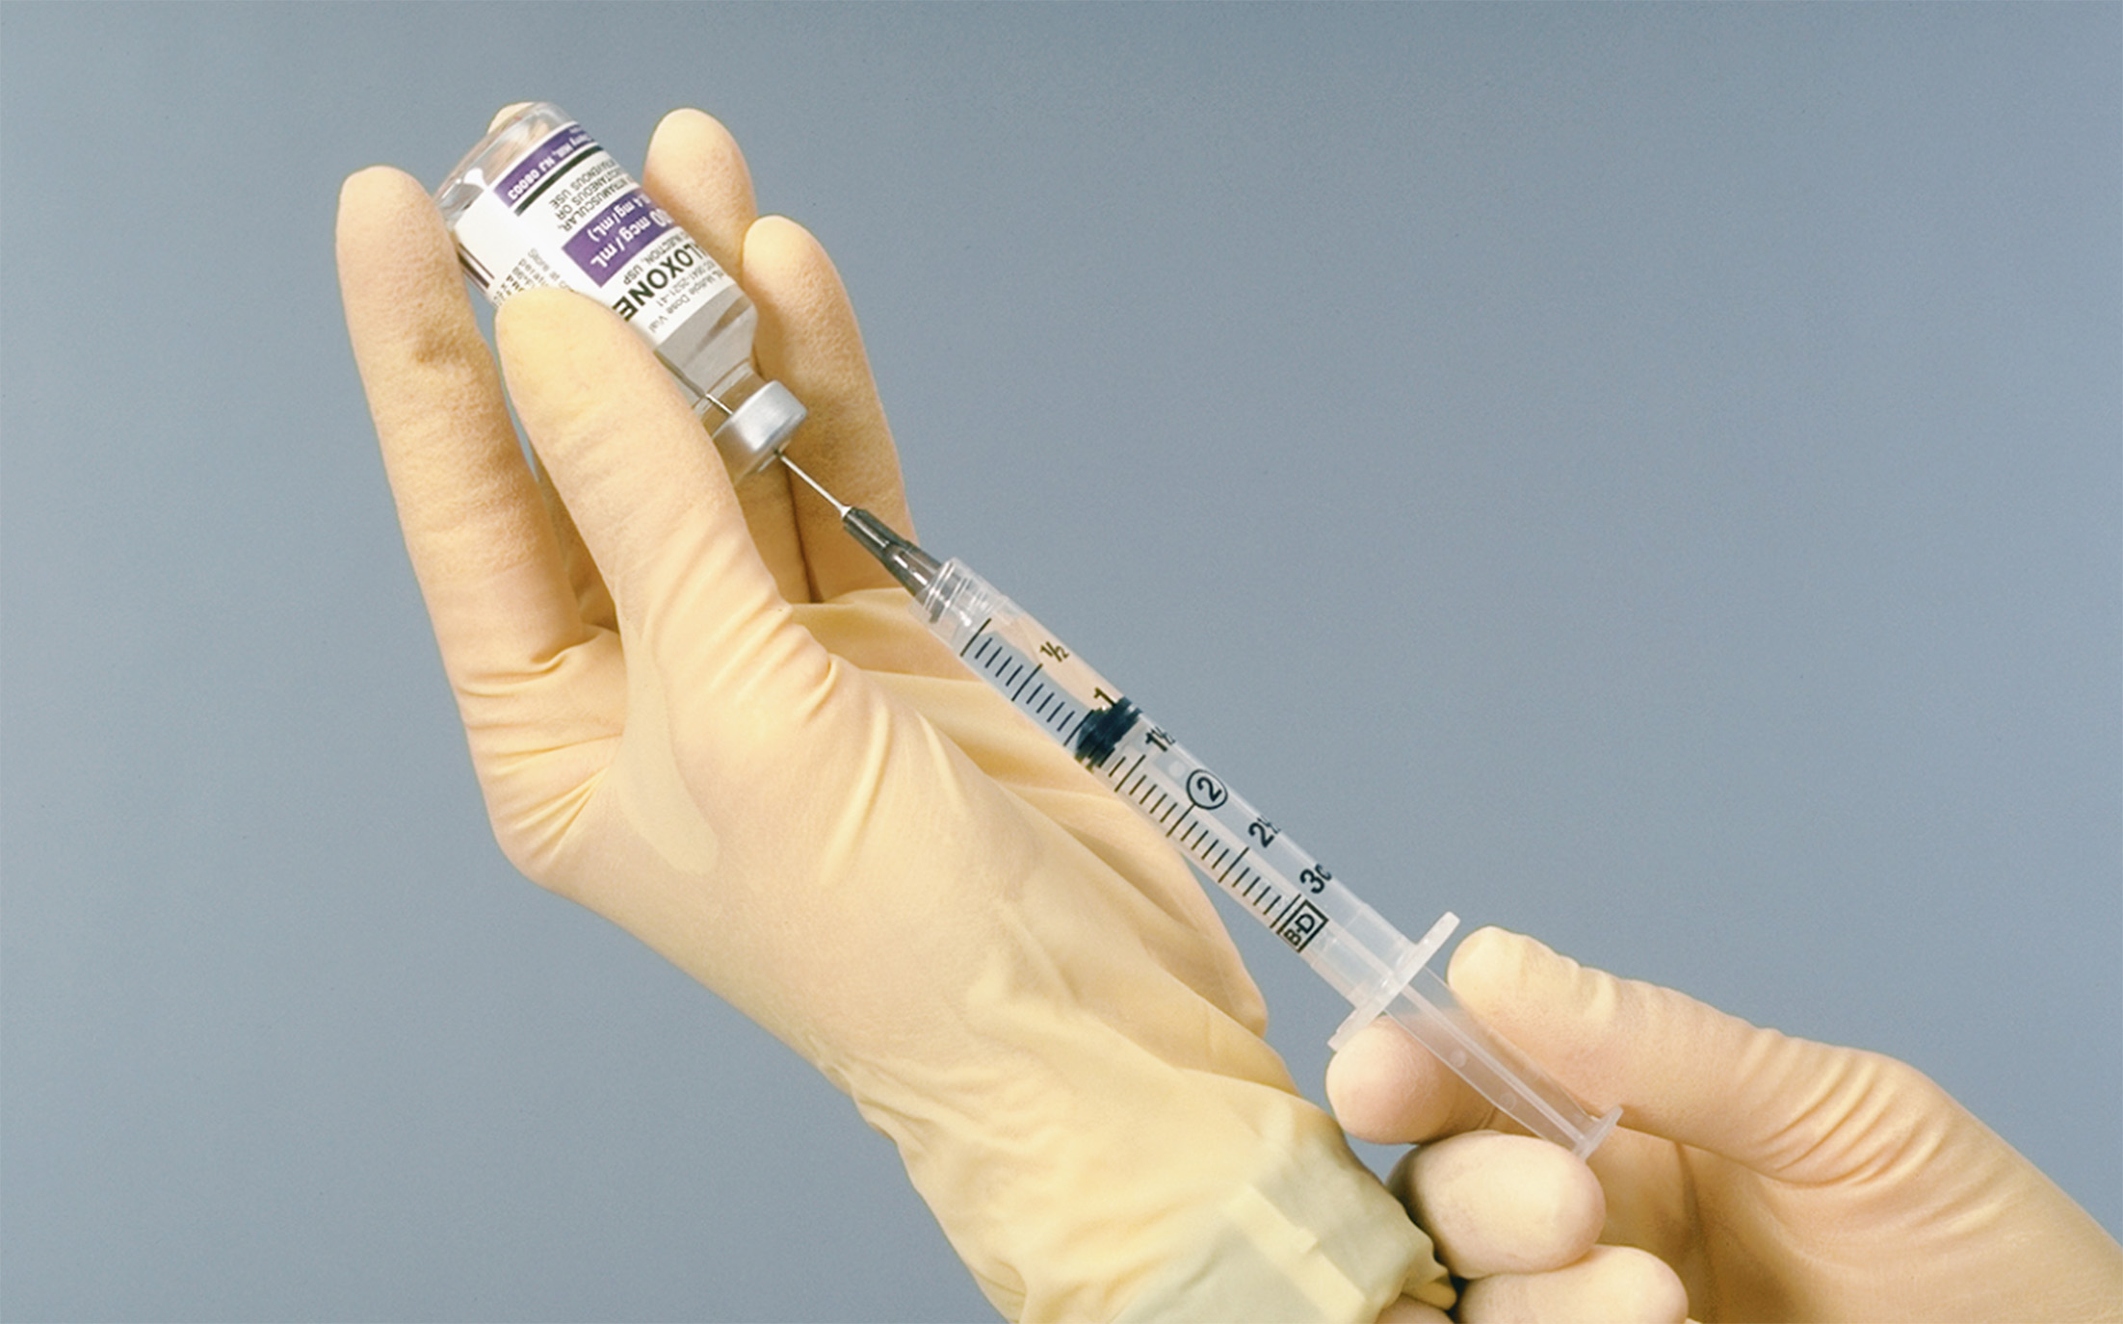
Figure 7-6 Drawing medication from a vial with a syringe.
Michal Heron/Pearson Education/PH College

Slide 35
Routes of Drug Administration
Parenteral Routes
  Intradermal injection (ID)
    Usually in inner forearm or upper back
      Just below epidermis into dermis
    Often used for tuberculin or allergy tests or to give local anesthetics
    Needle enters at 15-degree angle
    Produces small wheal on skin surface

Slide 36
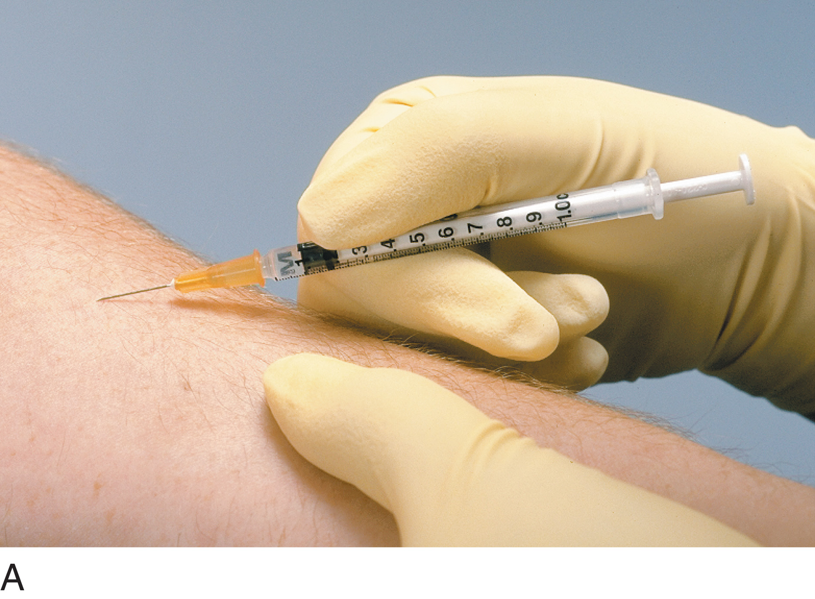
Figure 7-7 (A) Intradermal injection. (B) Subcutaneous injection. (C) Intramuscular injection.
Michal Heron/Pearson Education/PH College

Slide 37
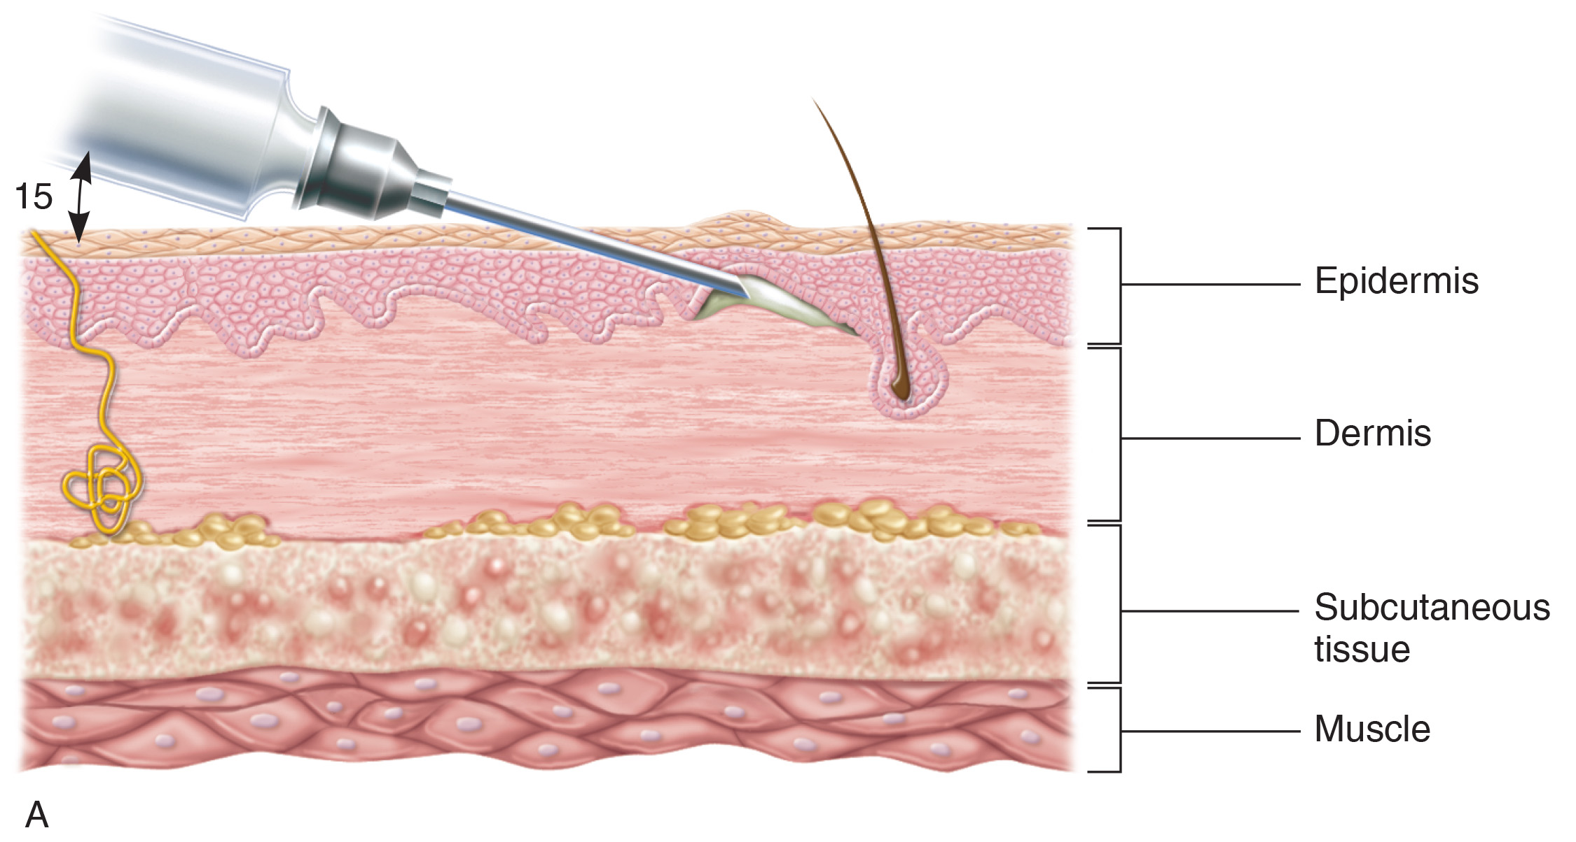
Figure 7-8 Angles and depths of injection for intradermal (A), subcutaneous (B), and intramuscular (C) injections.

Slide 38
Routes of Drug Administration
Parenteral Routes
  Subcutaneous injection
    Usually upper arms, back, or abdomen
    Commonly used for heparin and insulin
    45-degree angle usually used
      Based on patient weight
    Small volumes (0.5 to 1 mL) are given

Slide 39
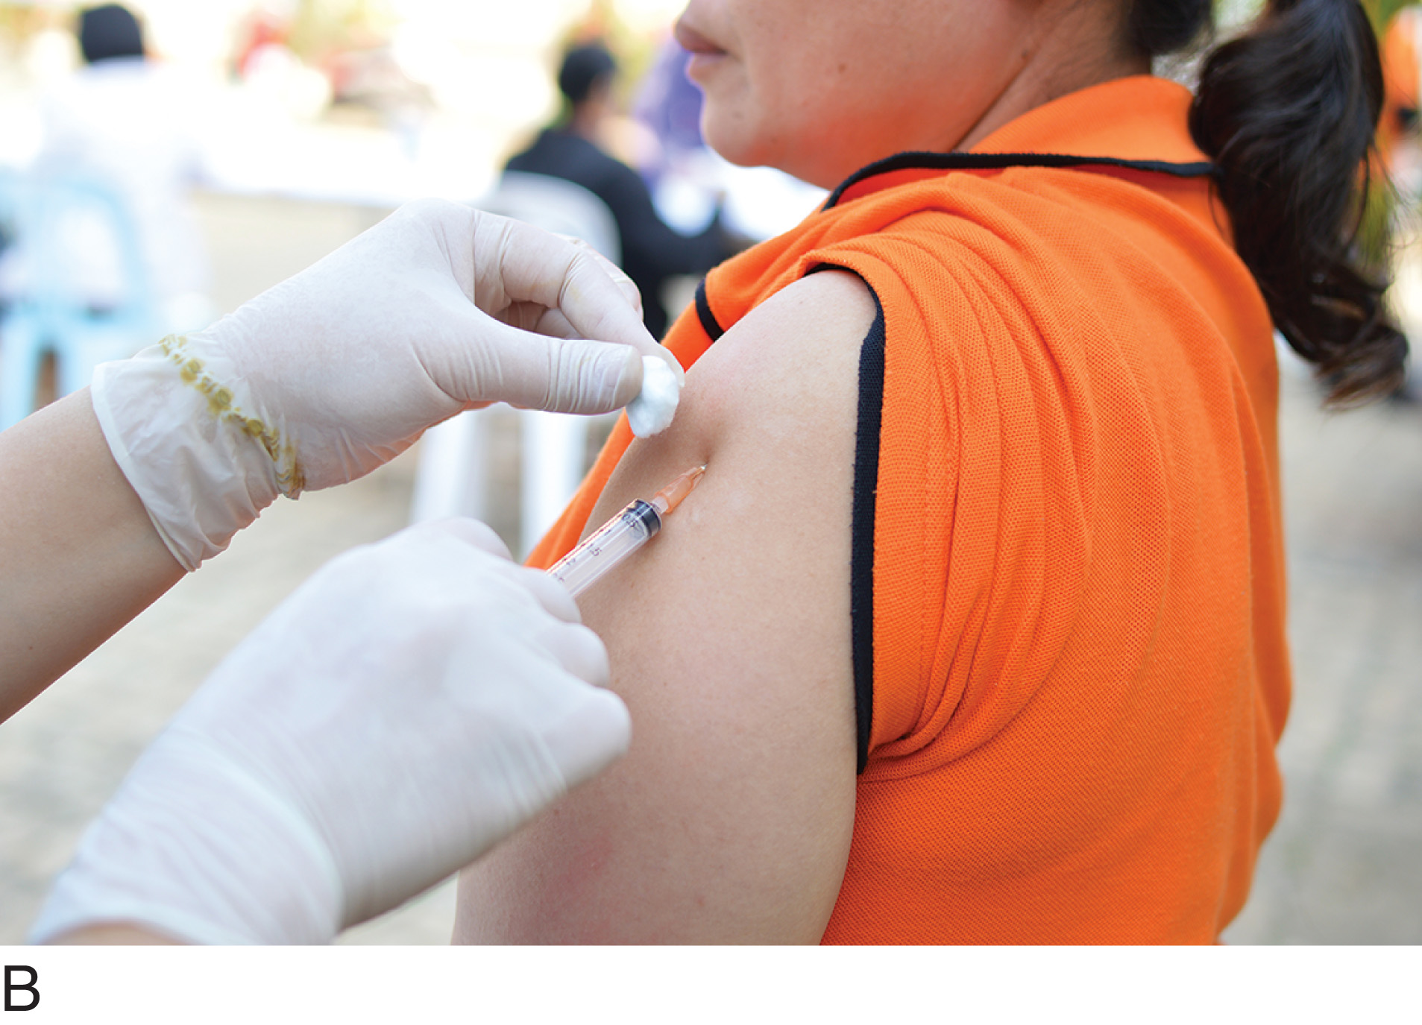
Figure 7-7 (continued) (A) Intradermal injection. (B) Subcutaneous injection. (C) Intramuscular injection.
Kuarmungadd/Fotolia

Slide 40
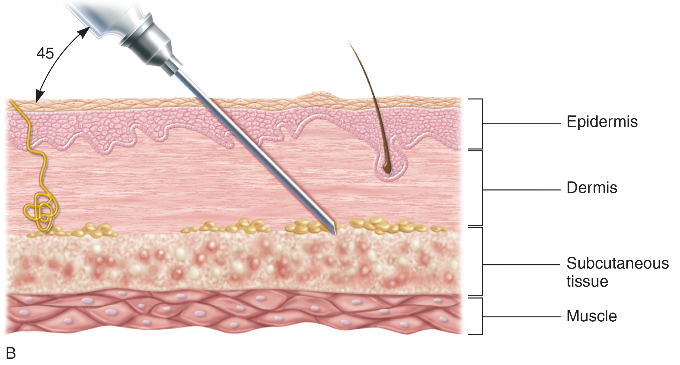
Figure 7-8 (continued) Angles and depths of injection for intradermal (A), subcutaneous (B), and intramuscular (C) injections.

Slide 41
Routes of Drug Administration
Parenteral Routes
  Intramuscular (IM) injections
    Usually upper arm, thigh, or hip muscles
    Commonly used for drugs that irritate subcutaneous tissue
    90-degree angle or Z-track method
    1 to 3 mL can be given IM

Slide 42
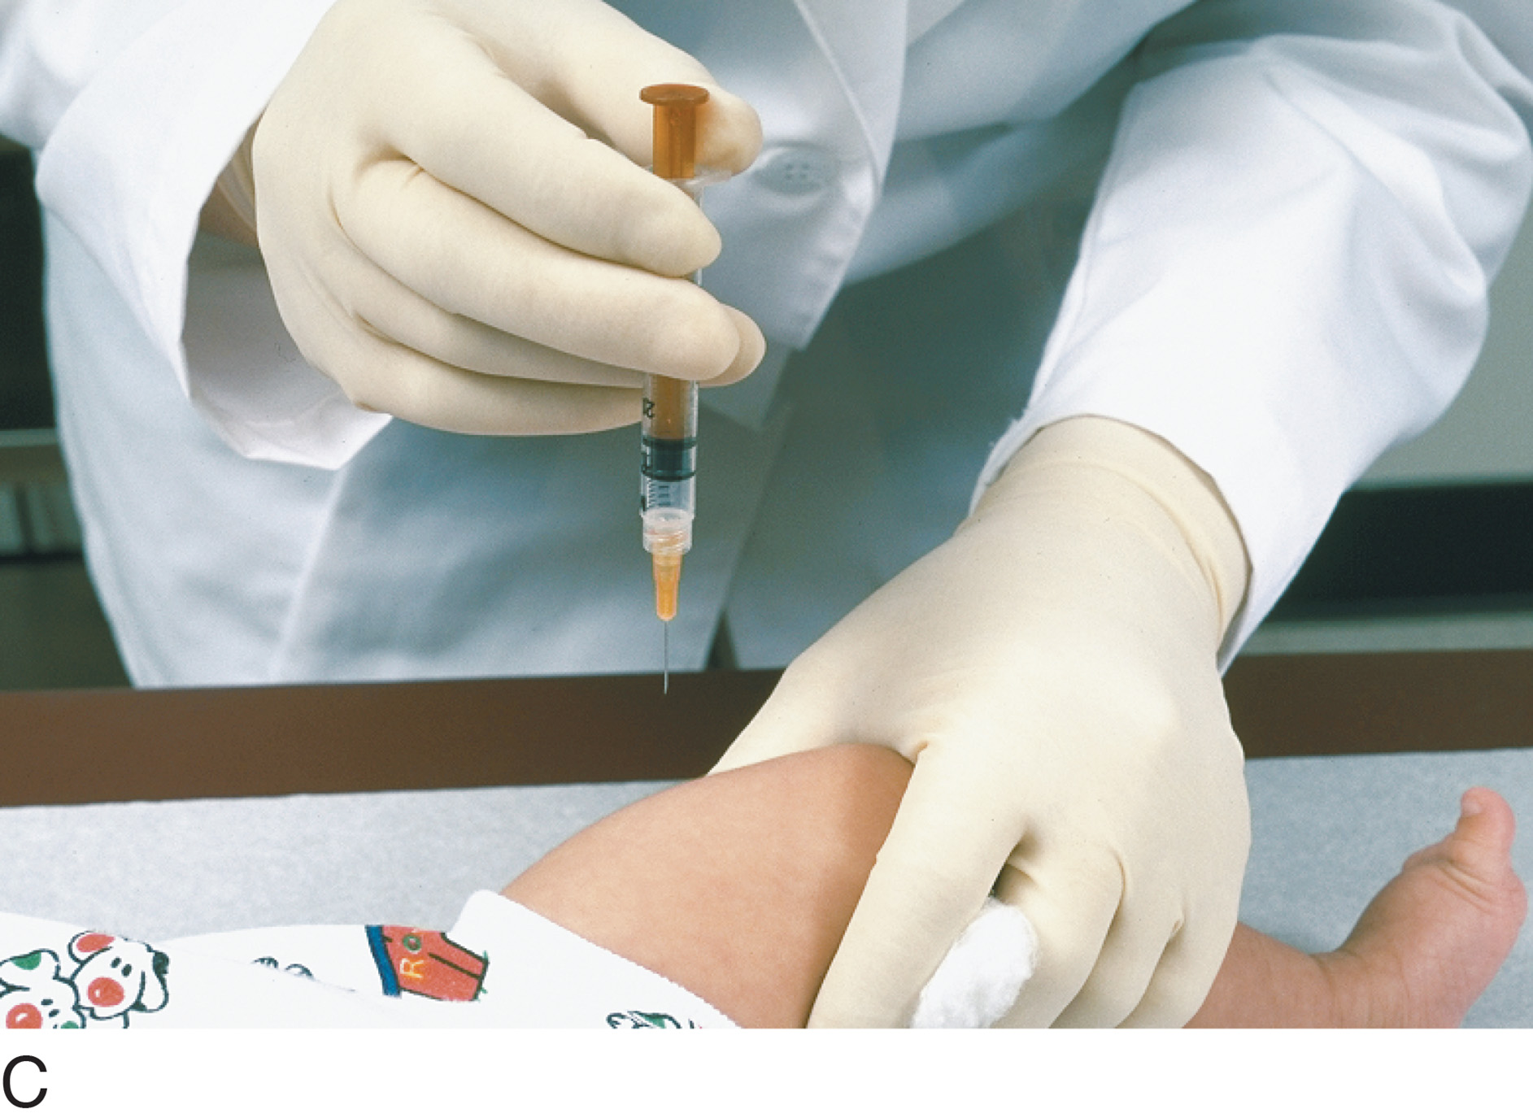
Figure 7-7 (continued) (A) Intradermal injection. (B) Subcutaneous injection. (C) Intramuscular injection.
Michal Heron/Pearson Education/PH College

Slide 43
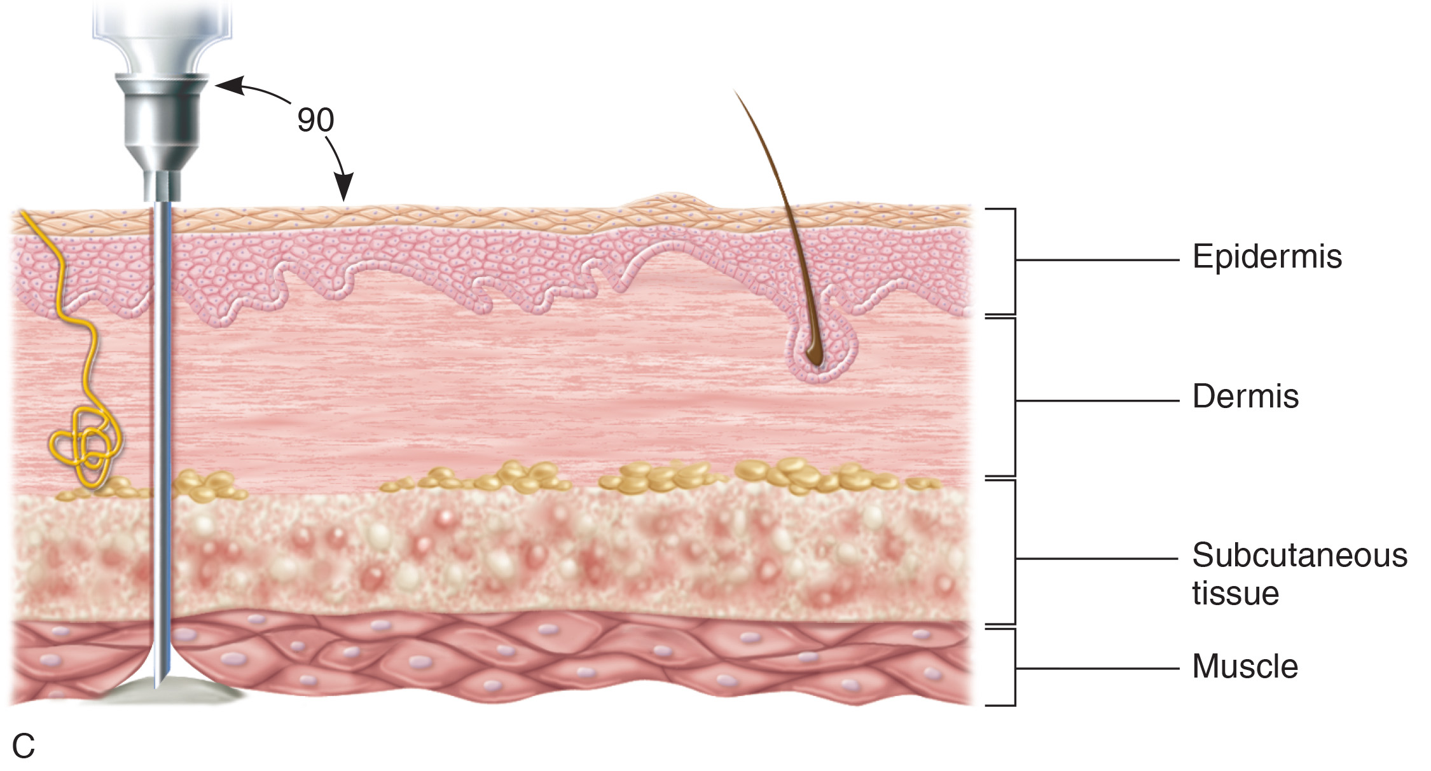
Figure 7-8 (continued) Angles and depths of injection for intradermal (A), subcutaneous (B), and intramuscular (C) injections.

Slide 44
Routes of Drug Administration
Parenteral Routes
  Intravenous injection
    Directly into veins, usually arms
      At short angle to the skin
    Used for many drugs and fluids
continued on next slide

Slide 45
Routes of Drug Administration
Parenteral Routes
  Intravenous injection
    May be given:
      Slowly
      Rapidly (IV push)
      By piggyback infusion
      Into existing IV line (IV port)
      Into intermittent access device (heparin lock)
      Added to IV solution
continued on next slide

Slide 46
Routes of Drug Administration
Other Routes of Drug Administration
  Transdermal medications
    Provide sustained-release administration
    Rate of drug delivery varies
      12 hours to 1 week
    Examples include:
      Nicotine
      Nitroglycerin
      Estrogen

Slide 47

Figure 7-9 Examples of transdermal patches.
Image Point Fr/Shutterstock
continued on next slide

Slide 48
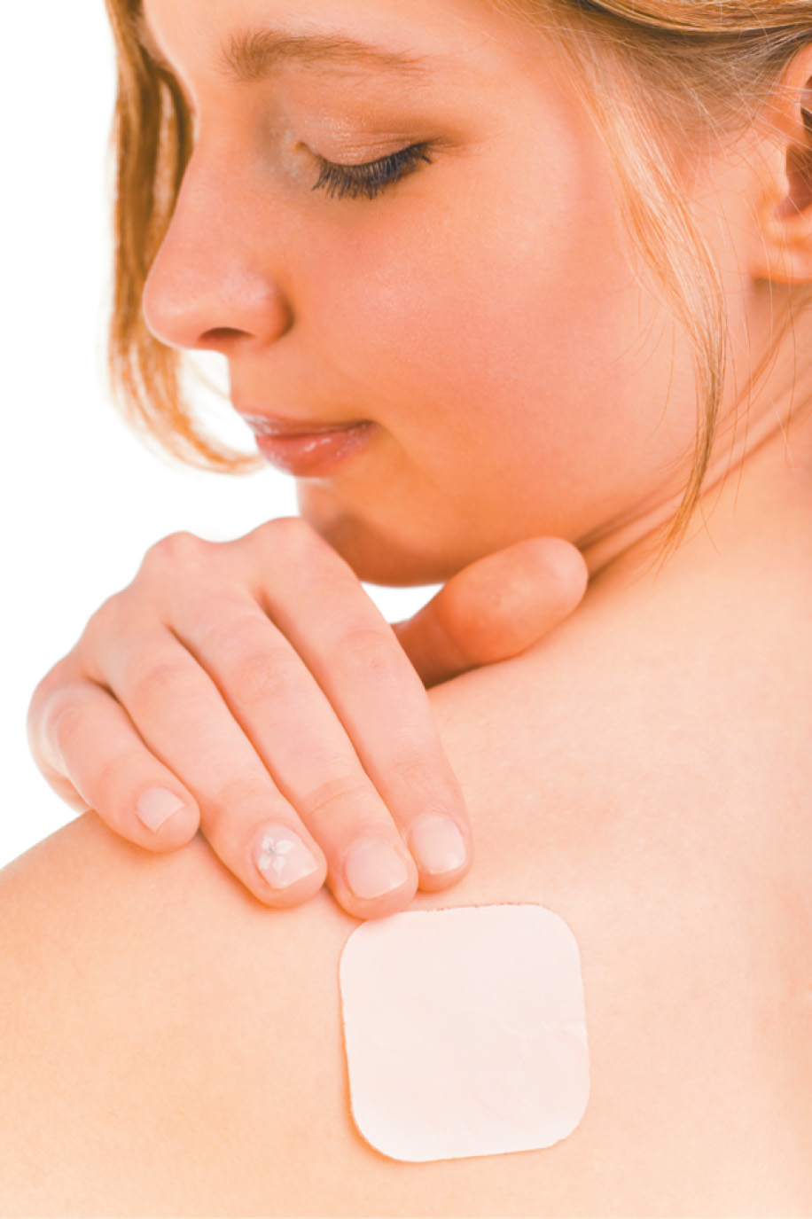
Figure 7-9 (continued) Examples of transdermal patches.
Tomasz Trojanowski/Shutterstock

Slide 49
Routes of Drug Administration
Other Routes of Drug Administration
  Ophthalmic route
    Administered to the eyes
    Instillations or irrigations – eye drops or ointments
    Sterile technique required
    Liquids usually diluted to less than 1% strength
    Irrigations used to wash out conjunctival sac

Slide 50
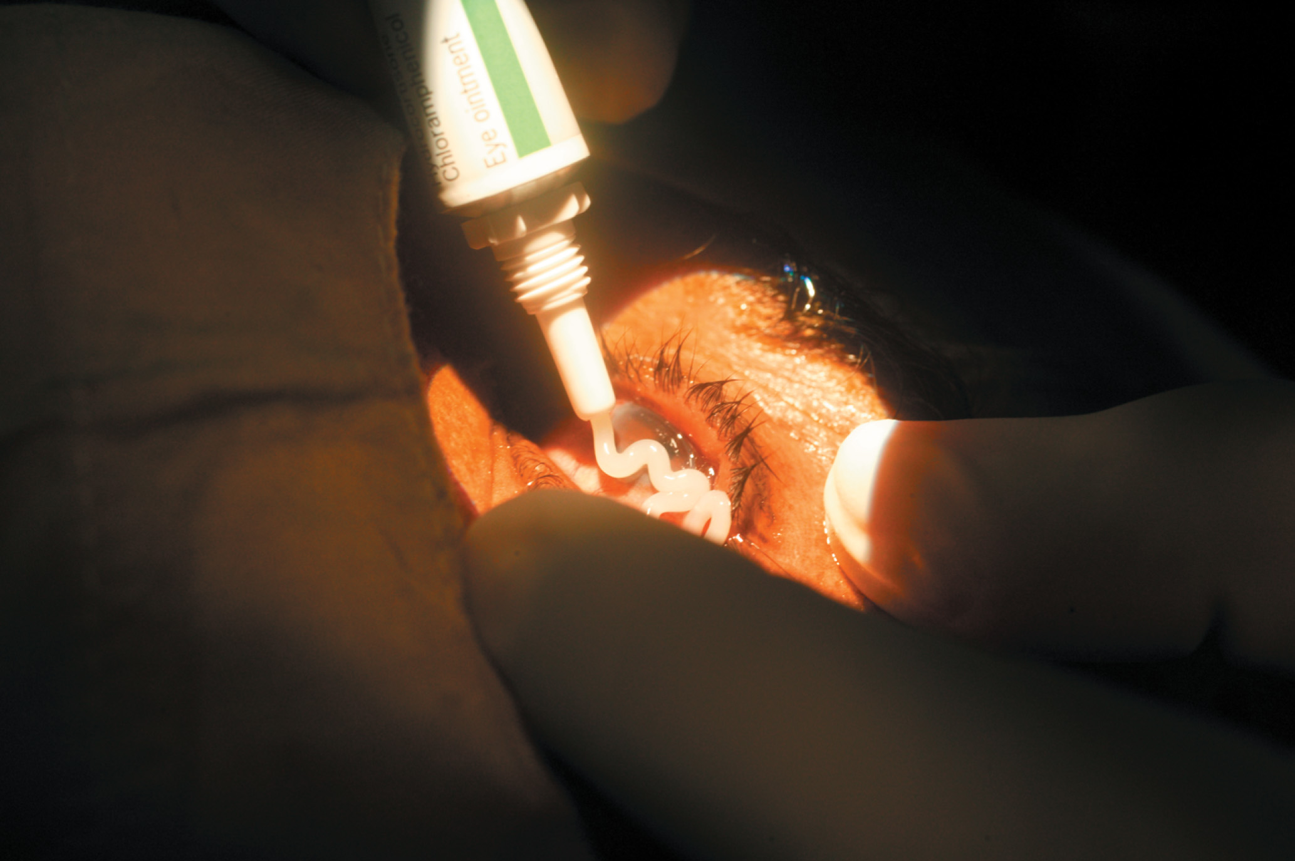
Figure 7-10 Instillation of eye ointment.
MedicImage/Universal Images Group/Getty images

Slide 51
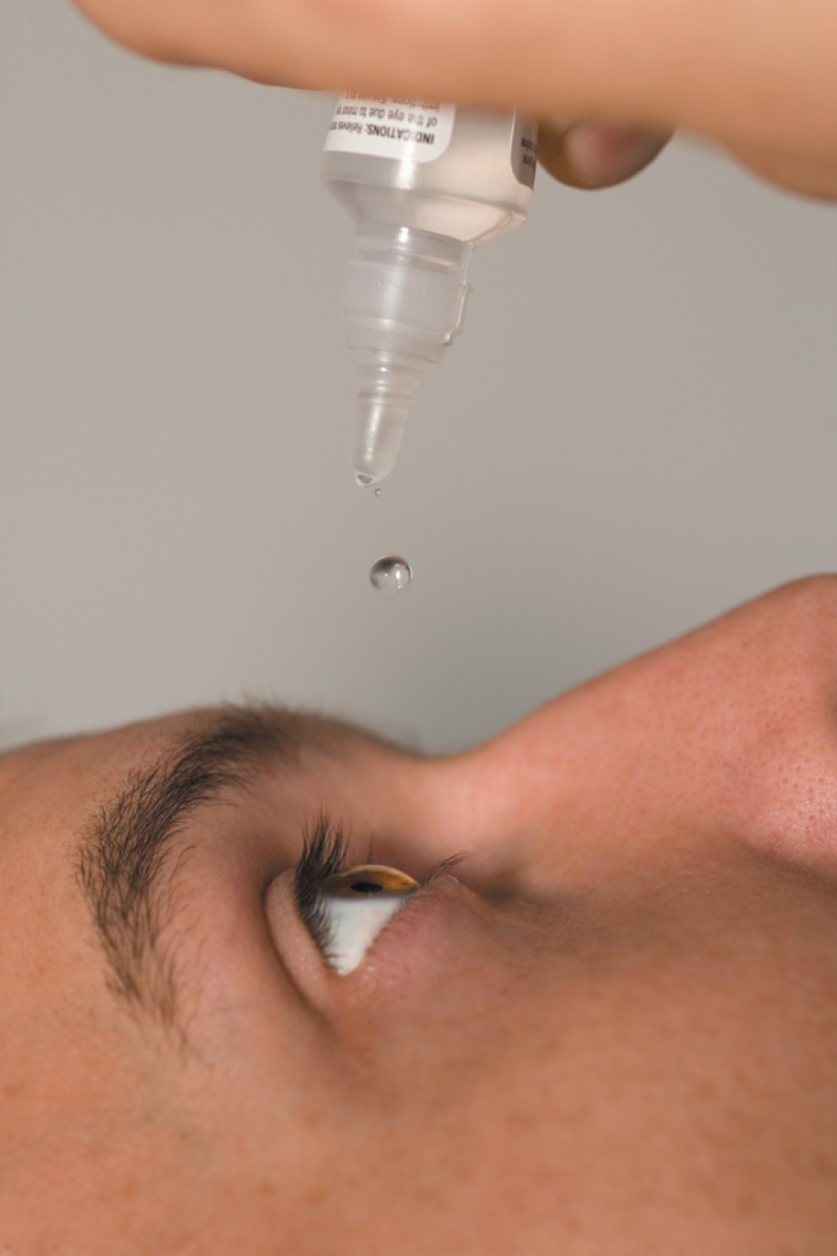
Figure 7-11 Instillation of eye drops.
Seth Joel/Photodisc/Getty Images

Slide 52
Routes of Drug Administration
Other Routes of Drug Administration
  Otic route
    For localized infection or inflammation
      Small amount of sterilized medication dropped into ear(s)
    Patient should lay on one side for 5 minutes
      Allows coating of inner ear canal with medication

Slide 53
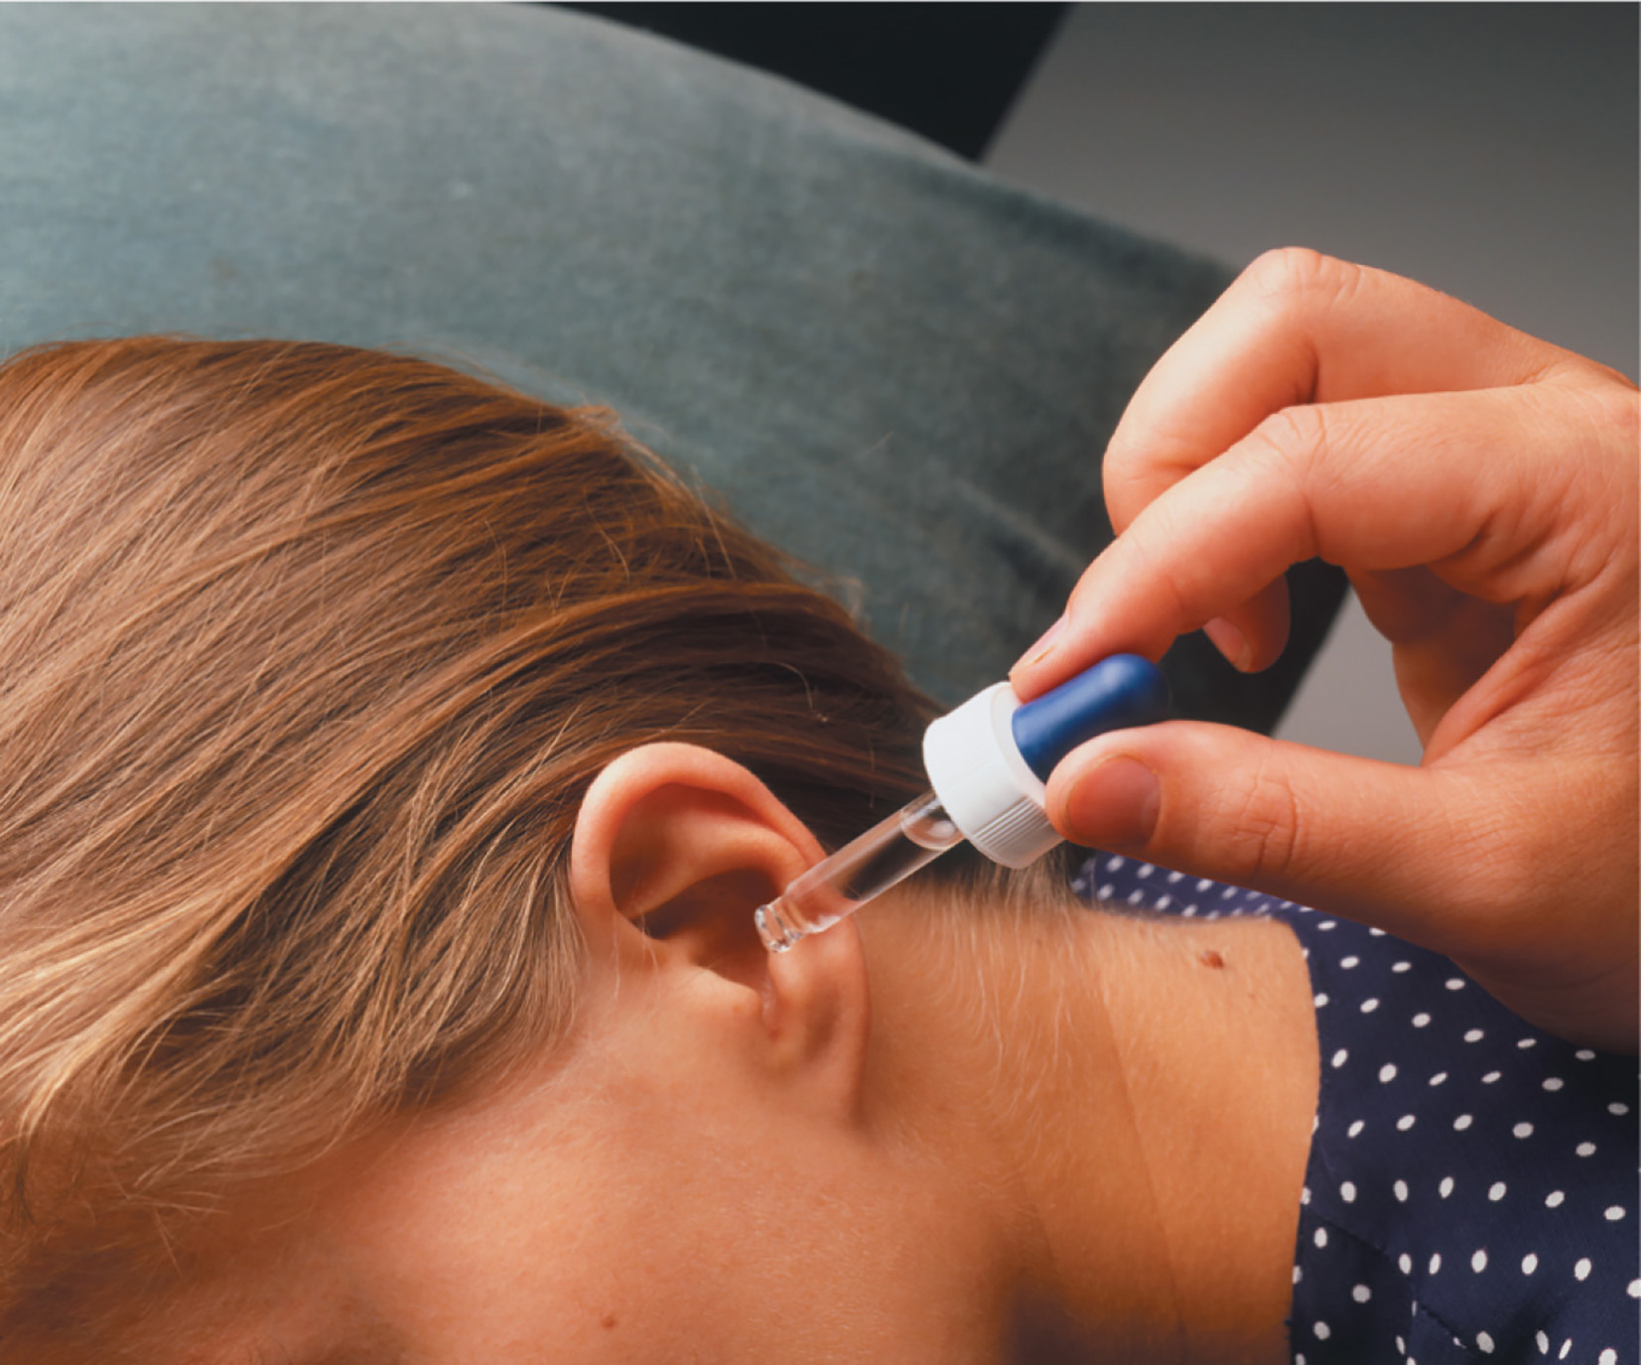
Figure 7-12 Instillation of ear medication.
Susanna Price/DK Images

Slide 54
Routes of Drug Administration
Other Routes of Drug Administration
  Nasal route
    Decongestants are most common instillations.
    Treat infections of nasal cavity of sinuses
    Many of these are OTC drugs.
    Via dropper or sprays
      Usually, patient is supine with head tilted back.

Slide 55
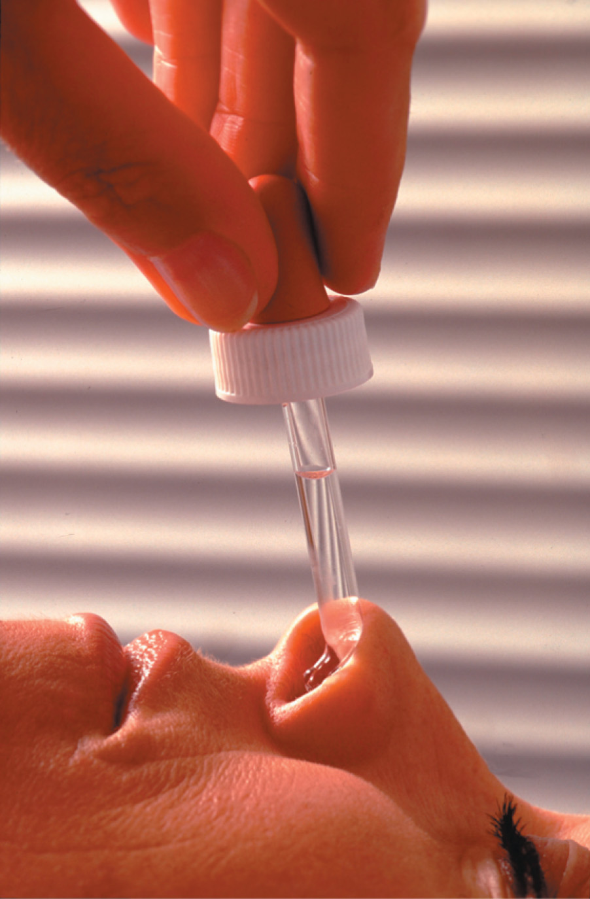
Figure 7-13 Administration of nasal medications.
Comnet/Prisma/AGE Fotostock

Slide 56
Routes of Drug Administration
Other Routes of Drug Administration
  Inhalation route
    Used for:
      Medicines
      Water vapor
      Gases
        Oxygen, carbon dioxide, helium
    Local effects in respiratory tract through aerosols, nebulizers, Spinhalers, or metered-dose inhalers (MDIs)
continued on next slide

Slide 57
Routes of Drug Administration
Other Routes of Drug Administration
  Inhalation route
    Oxygen is prescribed according to:
      Flow rate
        Liters per minute (LPM)
      Concentration
        Percentage (%)
      Delivery method
      Administration time
    Toxicity may develop when 100% oxygen is breathed for a prolonged period.
continued on next slide

Slide 58
Routes of Drug Administration
Other Routes of Drug Administration
  Inhalation route
    Predominant use for treatment of asthma or other pulmonary disorders
      Commonly administered by nebulizer
        Fine fog or mist
          Atomization or aerosolization
continued on next slide

Slide 59
Routes of Drug Administration
Other Routes of Drug Administration
  Inhalation route
    Predominant use for treatment of asthma or other pulmonary disorders
      Commonly administered by nebulizer
        Atomization
          Larger droplets inhaled
        Aerosolization:
          Droplets suspended in gas such as oxygen
          Smaller droplets inhaled further into respiratory system

Slide 60
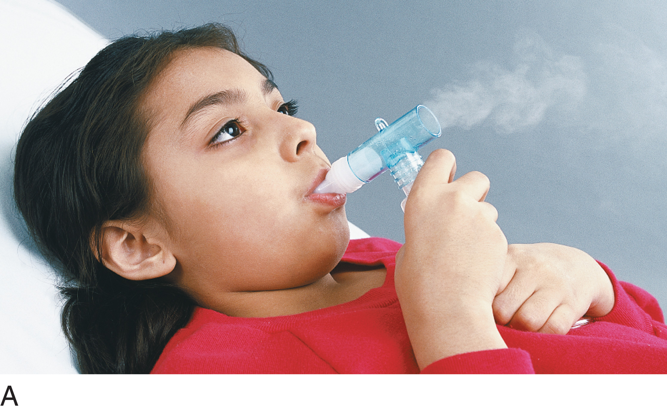
Figure 7-14 (A) A girl breathes mist through a nebulizer, with a bite piece in her mouth. (B) A breath-actuated inhaler. (C) An inhaler with a face mask.
Michal Heron/Pearson Education/PH College
continued on next slide

Slide 61
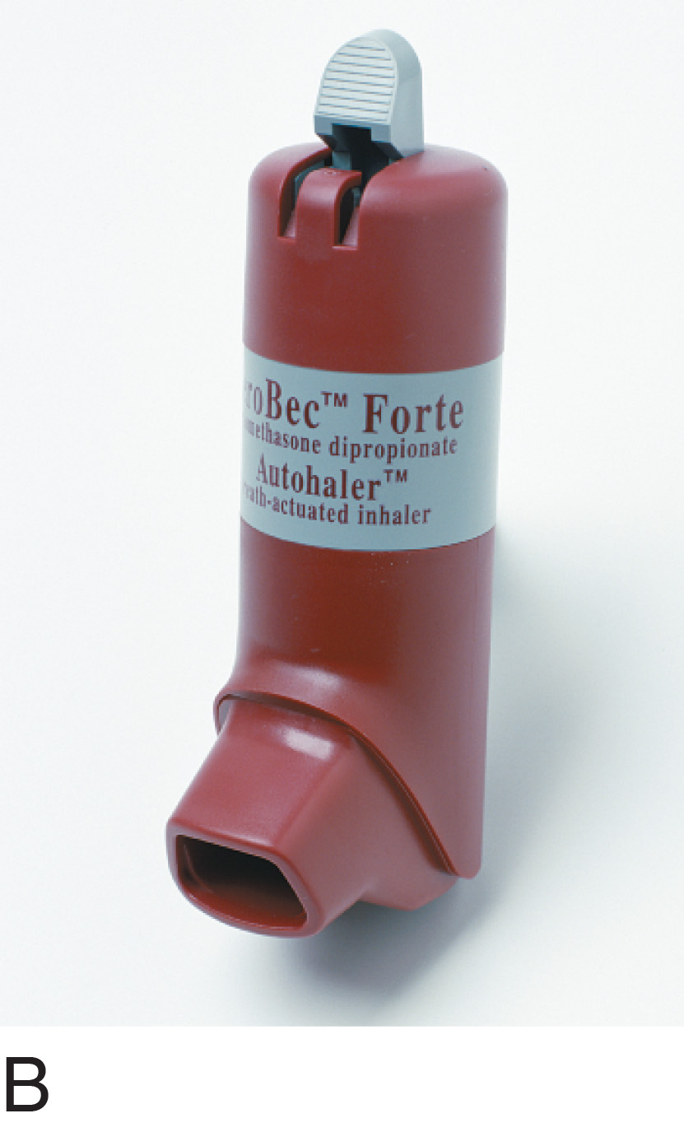
Figure 7-14 (continued) (A) A girl breathes mist through a nebulizer, with a bite piece in her mouth. (B) A breath-actuated inhaler. (C) An inhaler with a face mask.
Steve Gorton/DK Images
continued on next slide

Slide 62
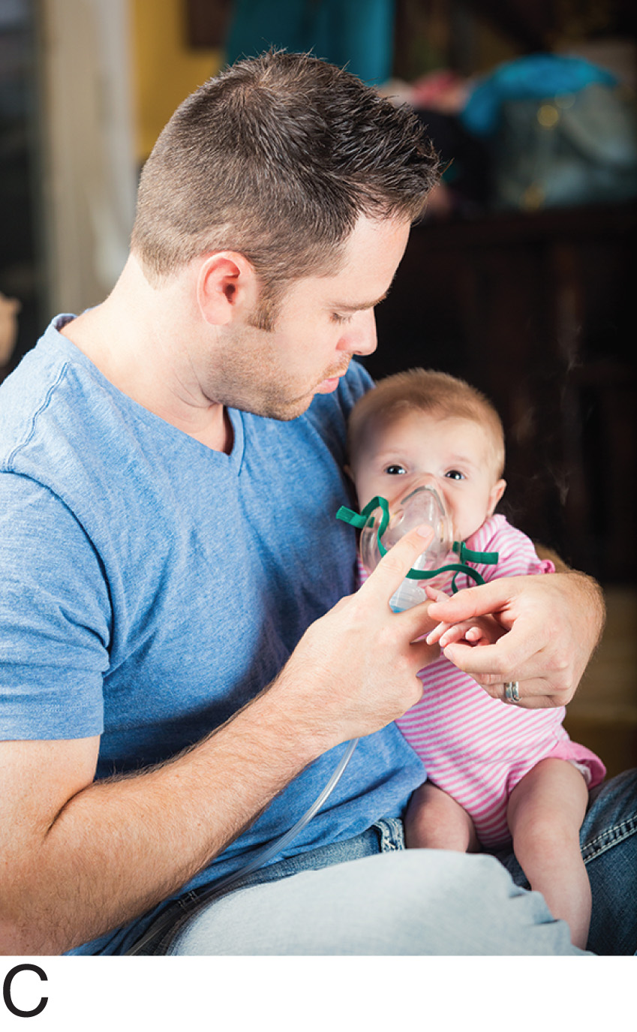
Figure 7-14 (continued) (A) A girl breathes mist through a nebulizer, with a bite piece in her mouth. (B) A breath-actuated inhaler. (C) An inhaler with a face mask.
Asiseeit/E+/Getty Images

Slide 63
Routes of Drug Administration
Other Routes of Drug Administration
  Inhalation route
    Metered-Dose Inhaler (MDI)
      A handheld nebulizer
        Pressured medication in container
        Patient uses it to release medication through nosepiece or mouthpiece

Slide 64
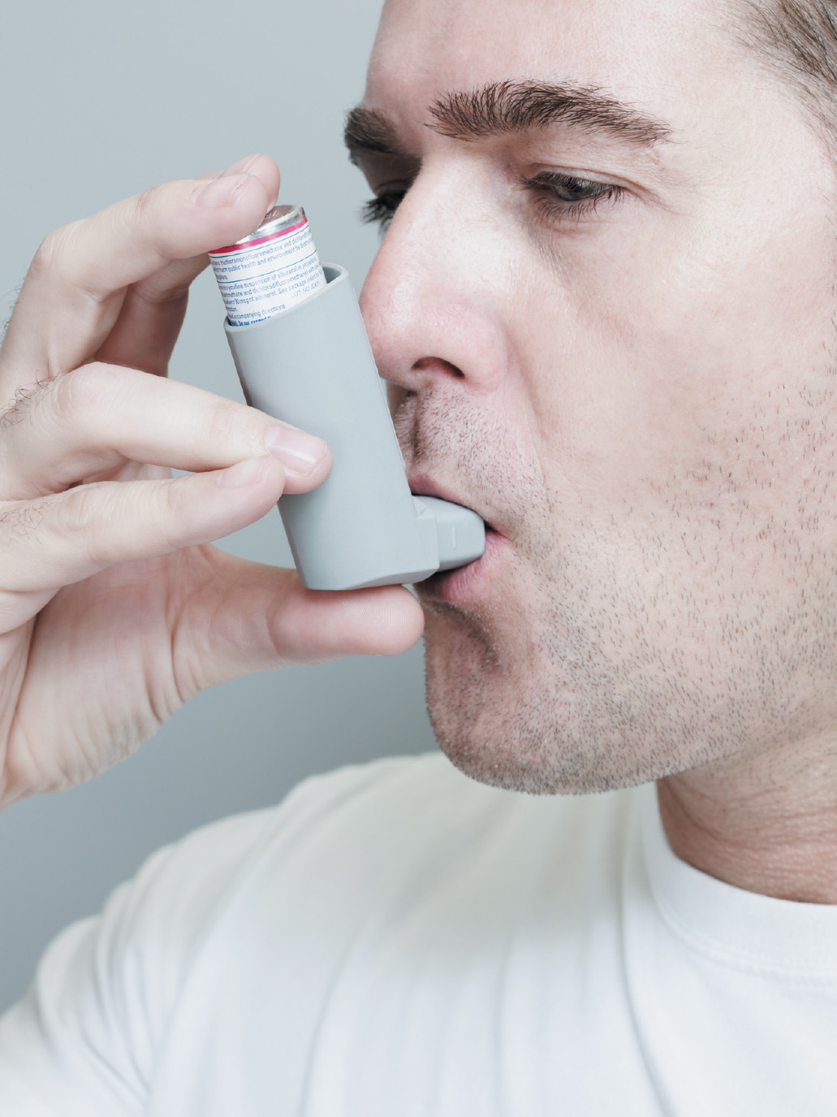
Figure 7-15 Metered-dose inhaler. ballyscanlon/Digital Vision/Getty Images

Slide 65
Routes of Drug Administration
Other Routes of Drug Administration
  Vaginal route
    Medications or instillations
      Creams, jellies, foams, suppositories
    Suppositories
      Inserted with finger of gloved hand
      Melt at body temperature
    Vaginal creams
      Instilled by using an applicator

Slide 66
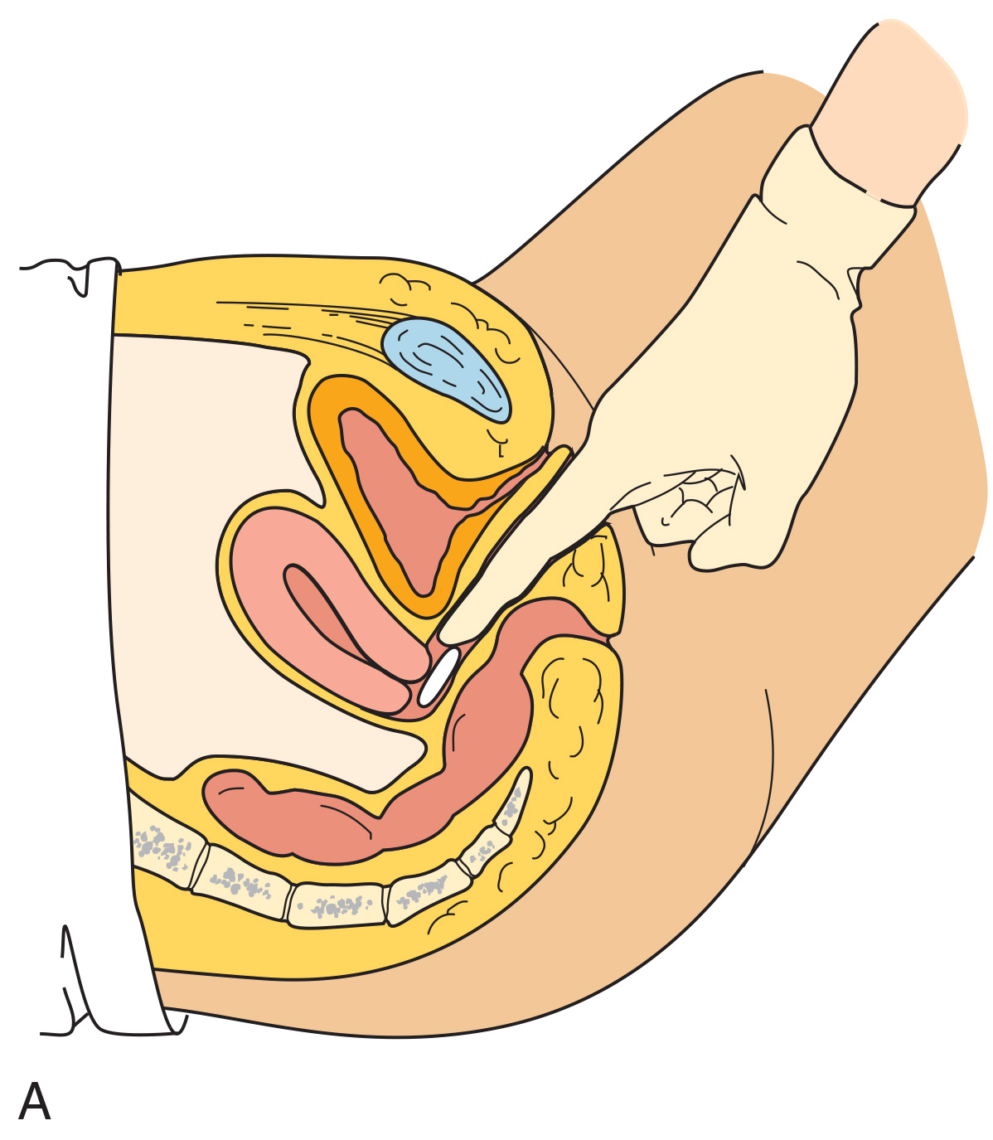
Figure 7-16 (A) Instilling vaginal suppositories. (B) Instilling vaginal cream by using an applicator.
continued on next slide

Slide 67
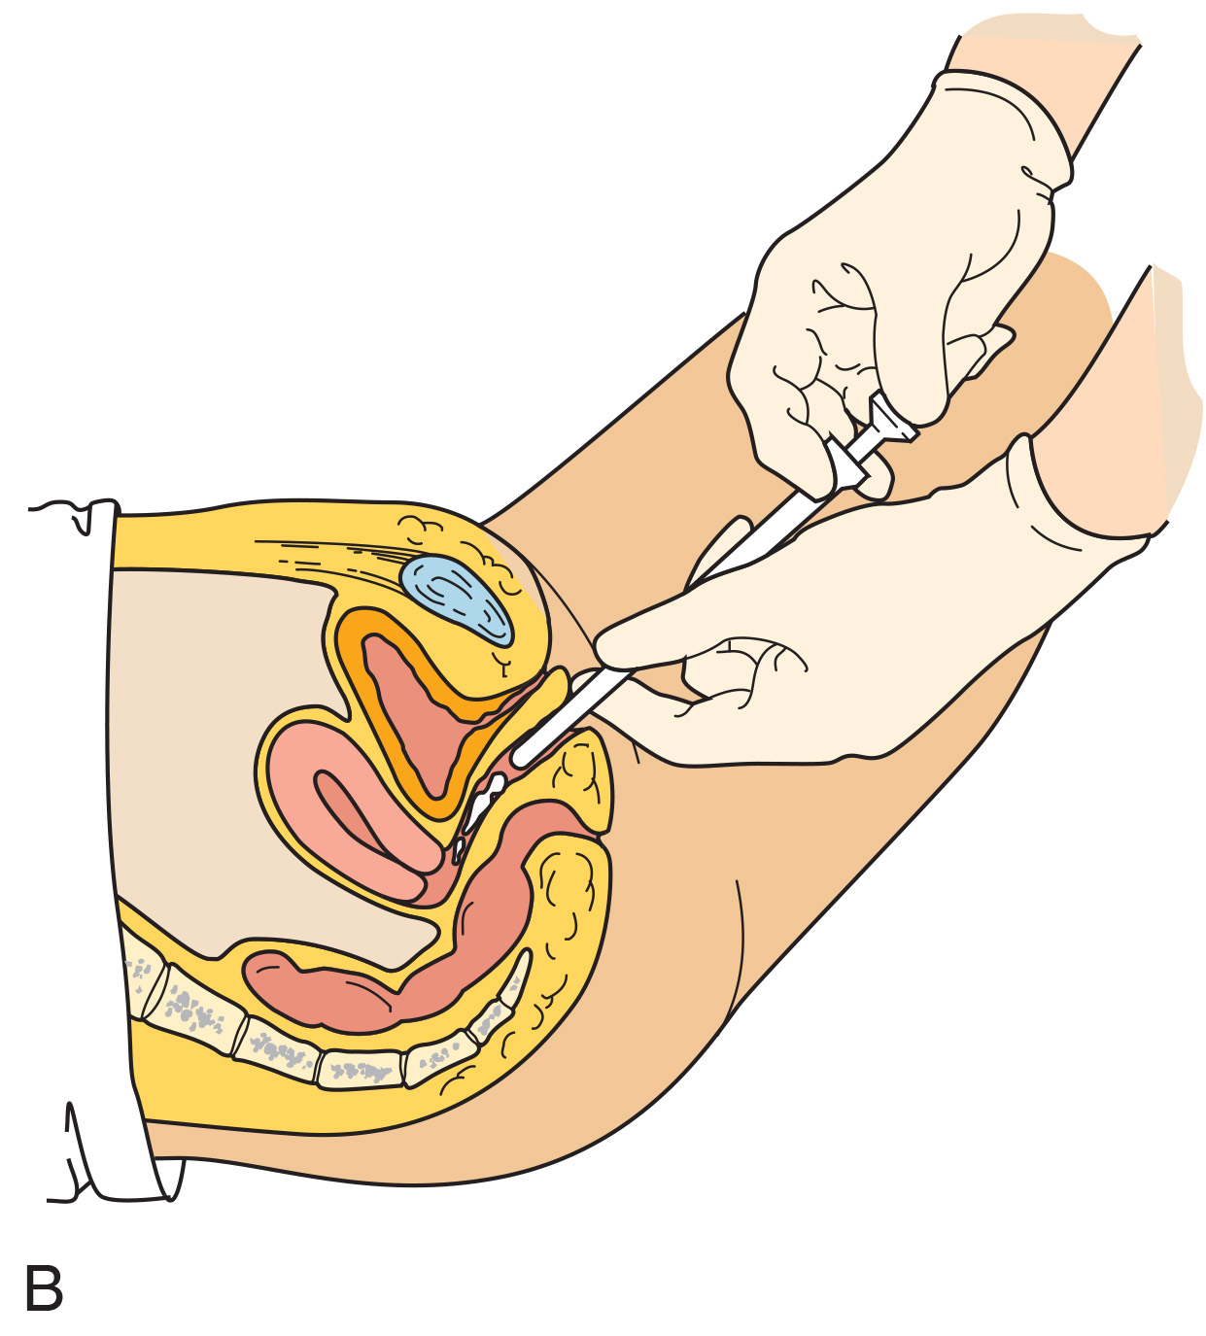
Figure 7-16 (continued) (A) Instilling vaginal suppositories. (B) Instilling vaginal cream by using an applicator.

Slide 68
Routes of Drug Administration
Other Routes of Drug Administration
  Rectal route
    Suppositories most often used
    Useful if patient is nauseated, vomiting, or unconscious
    May be solutions as an enema

Slide 69
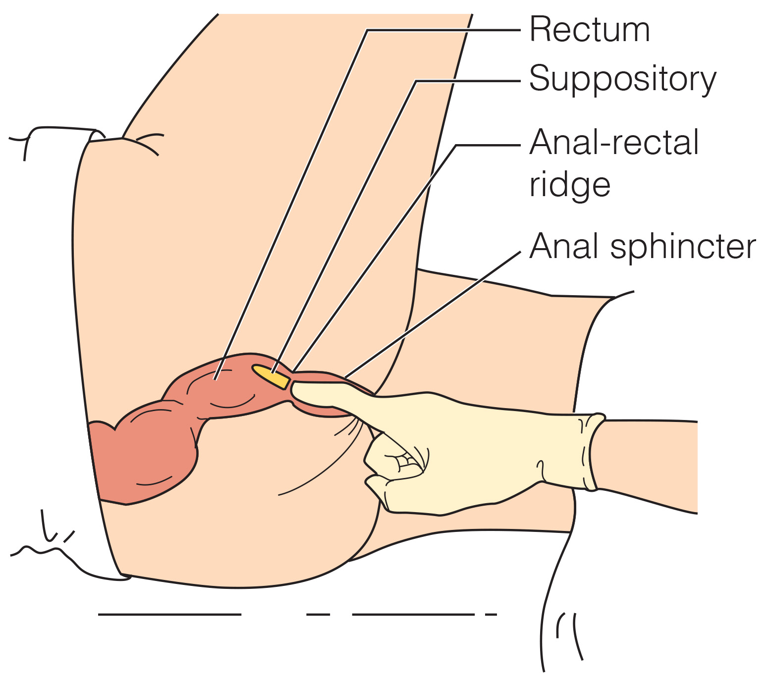
Figure 7-17 Inserting a rectal suppository into the anus.

